Slide 1


www.opengroup.org
Classification: Unrestricted
Notes:
Transcript
This is another video brought to you by The Open Group Healthcare Forum, which you can visit at www.opengroup.org. Now, lets get started. . .

Slide 2

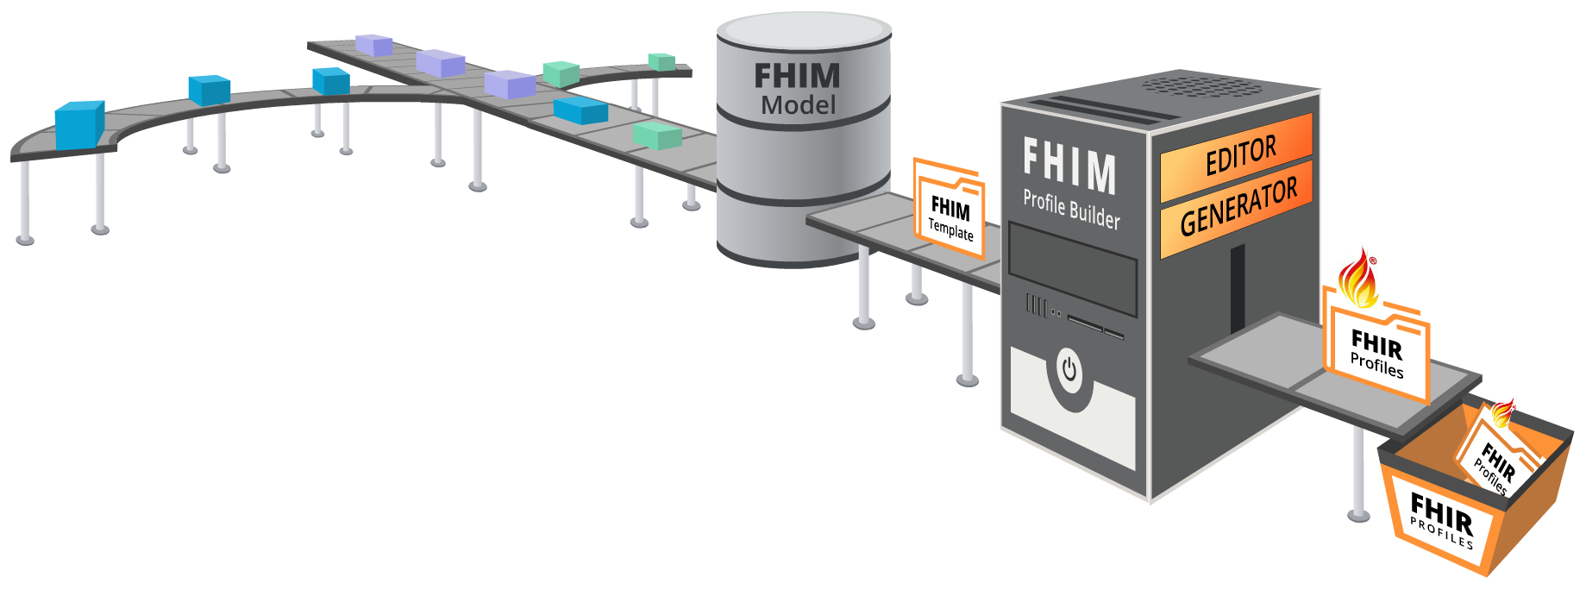
FHIM Profile Builder Process
2. Information
Modeling
3. Terminology
Modeling
1. Use Cases
4. FHIM Profile Builder
5. FHIR
Profiles
Classification: Unrestricted
Notes:
Transcript
This conceptual slide demonstrates the FHIM Profile Builder operations; where,
First, the FHIM Profile Builder(™) leverages the FHIM—its harmonization of standards via information and terminology modeling—for use in specific implementations.
Second, to make the FHIM easier to use, it provides a web-based Profile Editor to identify the information needed for an exchange.
And third, it provides a Profile Generator that interfaces with the Editor and produces F-H-I-R, pronounced “FIRE” profiles that are consistent and re-useable. . .

Slide 3

FHIM Profile Builder™
FPB Generator
Sean Muir, Software Engineer, JKMsoftware
Federated Health Information Model
Classification: Unrestricted
Notes:
FPB Profile Generator Demonstration-Video Transcript
Sean Muir, Software Engineer, JKMsoftware
2019-08-20
Welcome. We will be discussing in detail the steps, processes and technologies leveraged by the FBP to produce a FHIR profile. As discussed in the Editor section, the operations are FHIR based so the content that is exchanged between the Generator and the Editor are 100% FHIR compliant. The underlying services leverage Unified Modeling Language (UML), Model Driven Health Tools (MDHT), and Model Driven Message Interoperability (MDMI) to produce the FHIR profile
The core of the FHIM effort is the definition of an information model describing exchange requirements. This is stored in UML a part of model repository on the Generator. This repository is what the FPB leverages to provide content to the Editor.
Traceability between the various models and standards is key to the FPB and this is accomplished through the use of the MDMI Semantic Element Exchange Registry (SEER). The SEER allows for the FBP to match the FHIM model element describing immunizations to the FHIR component defining the same content.
The last bit of functionality needed is the ability to generate the appropriate artifacts, in this case FHIR Structured Definitions. MDHT for FHIR is able to generate valid FHIR Artifacts such as Structure Definitions.
These features have been encapsulated as part a modeling service platform exposed through a series of web service calls which is leveraged by the Editor.
Get by Name Service
As described previously, there is a model repository that has been created to provide access to FHIM components through a FHIR API query. The functionality is straightforward and after the request is made a collection of structure definitions are returned based on the results of the query against the FHIM.
Post Service
This step involves taking the requirements captured by the Editor and returning them to the Generator as a structure definition. The FBP service takes this structure definition input and creates the corresponding model components and stores it in the FHIM repository. When this is completed, the service will return the unique id for the FHIM template
Insert image of FHIM Template
Generate Service
The generate service is an operation that takes in the id to a FHIM template and returns in this case a corresponding ID for the generated FHIR profile. It is composed of a set of four sub processes,
Step 1 identify the semantically congruent components using MDMI SEER,
The SEER provides the ability to compare and contrast disparate models by providing a common language to identify elements in the models. The first step looks for the concepts defined as part of the FHIM Template located in the MDHT FHIR repository. The results are broken up into those concepts that are common in both the repository and the template or missing in repository.
Step 2, Calculate the deltas,
The next step evaluates what is common in both to create deltas for aspects such as cardinality and terminology. These deltas are then expressed in the FHIR Profile. Then the missing concepts in the target are evaluated and in the case of FHIR these are expressed as extensions. When this process is complete, there is a representation of the FHIM Template as a FHIR profile within MDHT.
Step 3 Save the resulting FHIR Profile in MDHT,
Save the FHIR Profile to the repository
Step 4, Generate FHIR structure definition
MDHT for FHIR has built in support for generating FHIR artifacts and it is at this time the FHIR structure definition representing the FHIR profile is generated and stored in the FHIM model repository. Last but not least, an ID is returned for the new FHIR profile structure definition.
Step 4, Get by Id Service
Using the ID from step 3, you can retrieve the FHIR profile.

Slide 4



Thank You!
We look forward to your participation
j.lee@opengroup.org
(774) 444-0880
@jasonsleephd
Classification: Unrestricted
Notes:
Transcript
Thank you for watching this FHIM Profile Builder video.
We have just started to demonstrate its value.
Please join us as we further develop this important tool.

